Slide 1
Project: Evangelical Youth Center of Tiogo (Burkina Faso)
Vision: To provide an excellent and affordable Christian education for multitudes of youth (ages 6-19) and train them to be disciples of Christ through biblical values and the preaching and teaching of the Gospel.
Location: Burkina Faso, West-Africa

Slide 2
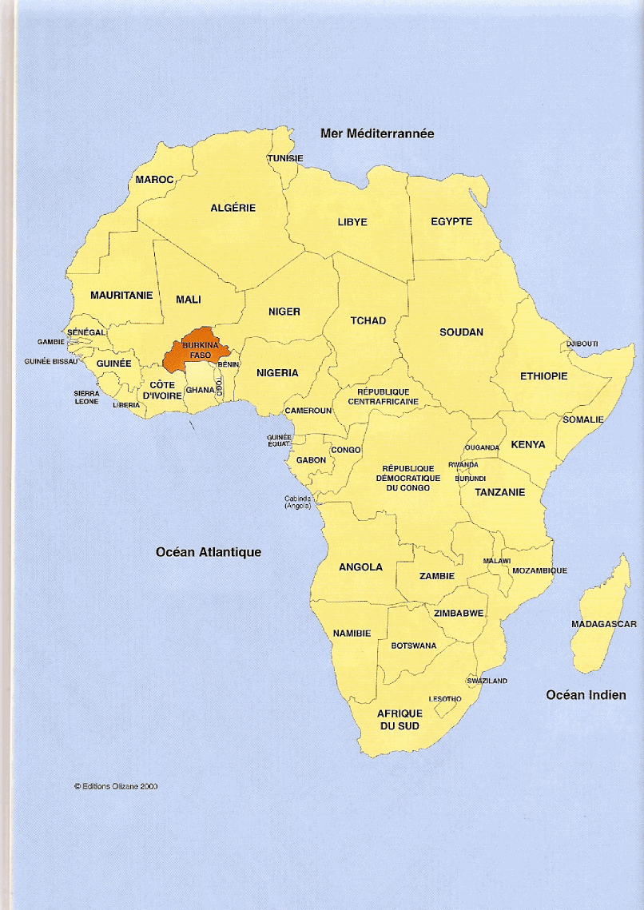

Slide 3
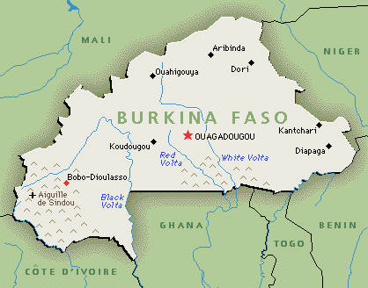
Tiogo, the village where the school will be built, is 35 km west of the town of Koudougou or 135 km from Ouagadougou, the capital city

Slide 4
A few facts about Burkina Faso
Population: 17 million
Area: 274200 km2
Population Under 15 yrs of age: 50%
Official Language: French
Christianity: about 20%
Islam: about 50 %
Animism and others: 30%
National Literary rate: mediocre

Slide 5
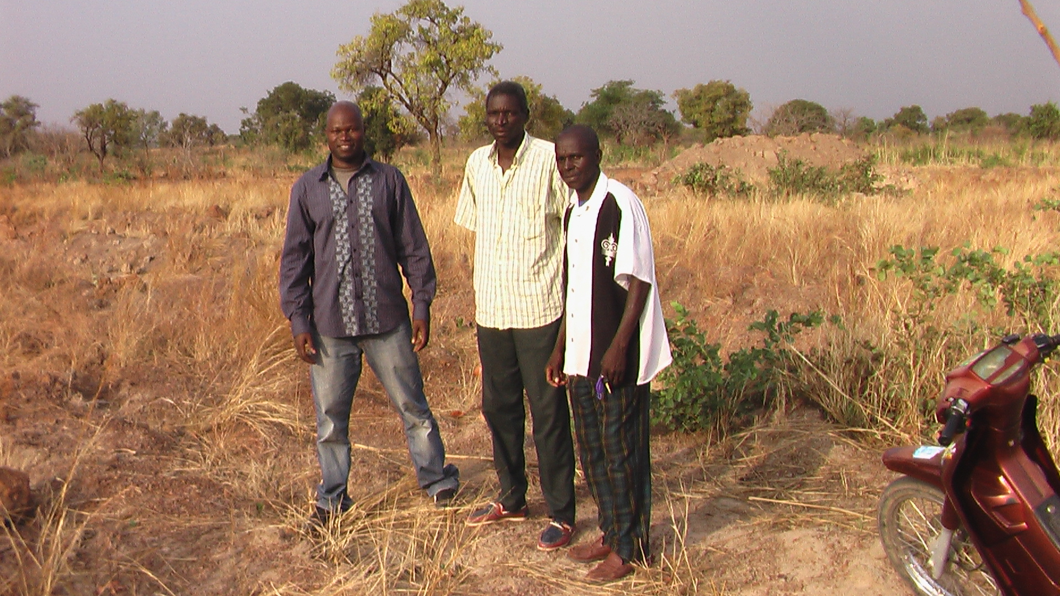
Land given by villagers

Slide 6
Facts about Land
Area of land given: 24 Acres
Legal paper work for land still in process
Land surrounded by several villages
Access to electricity in the village

Slide 7
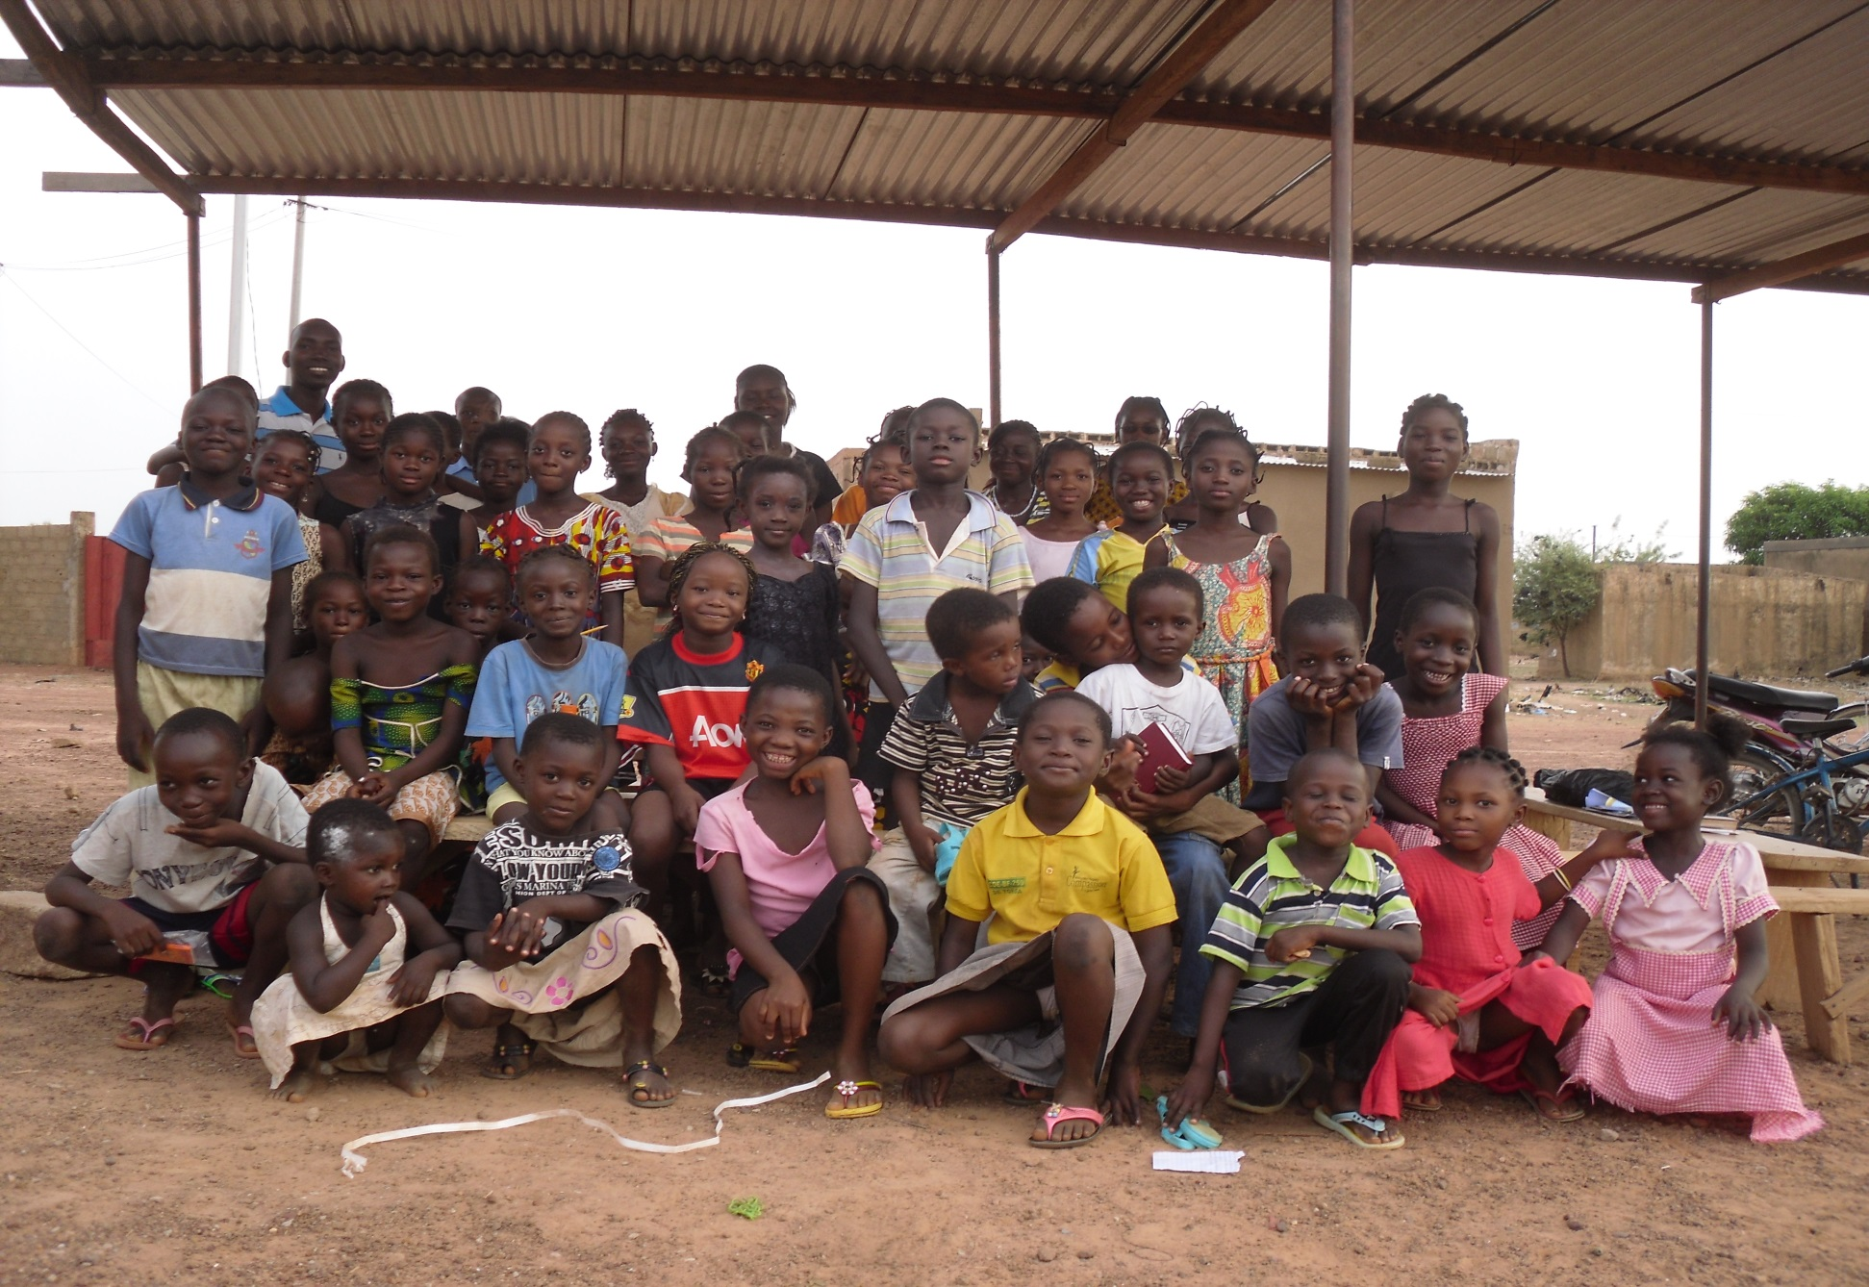
Potential Students

Slide 8
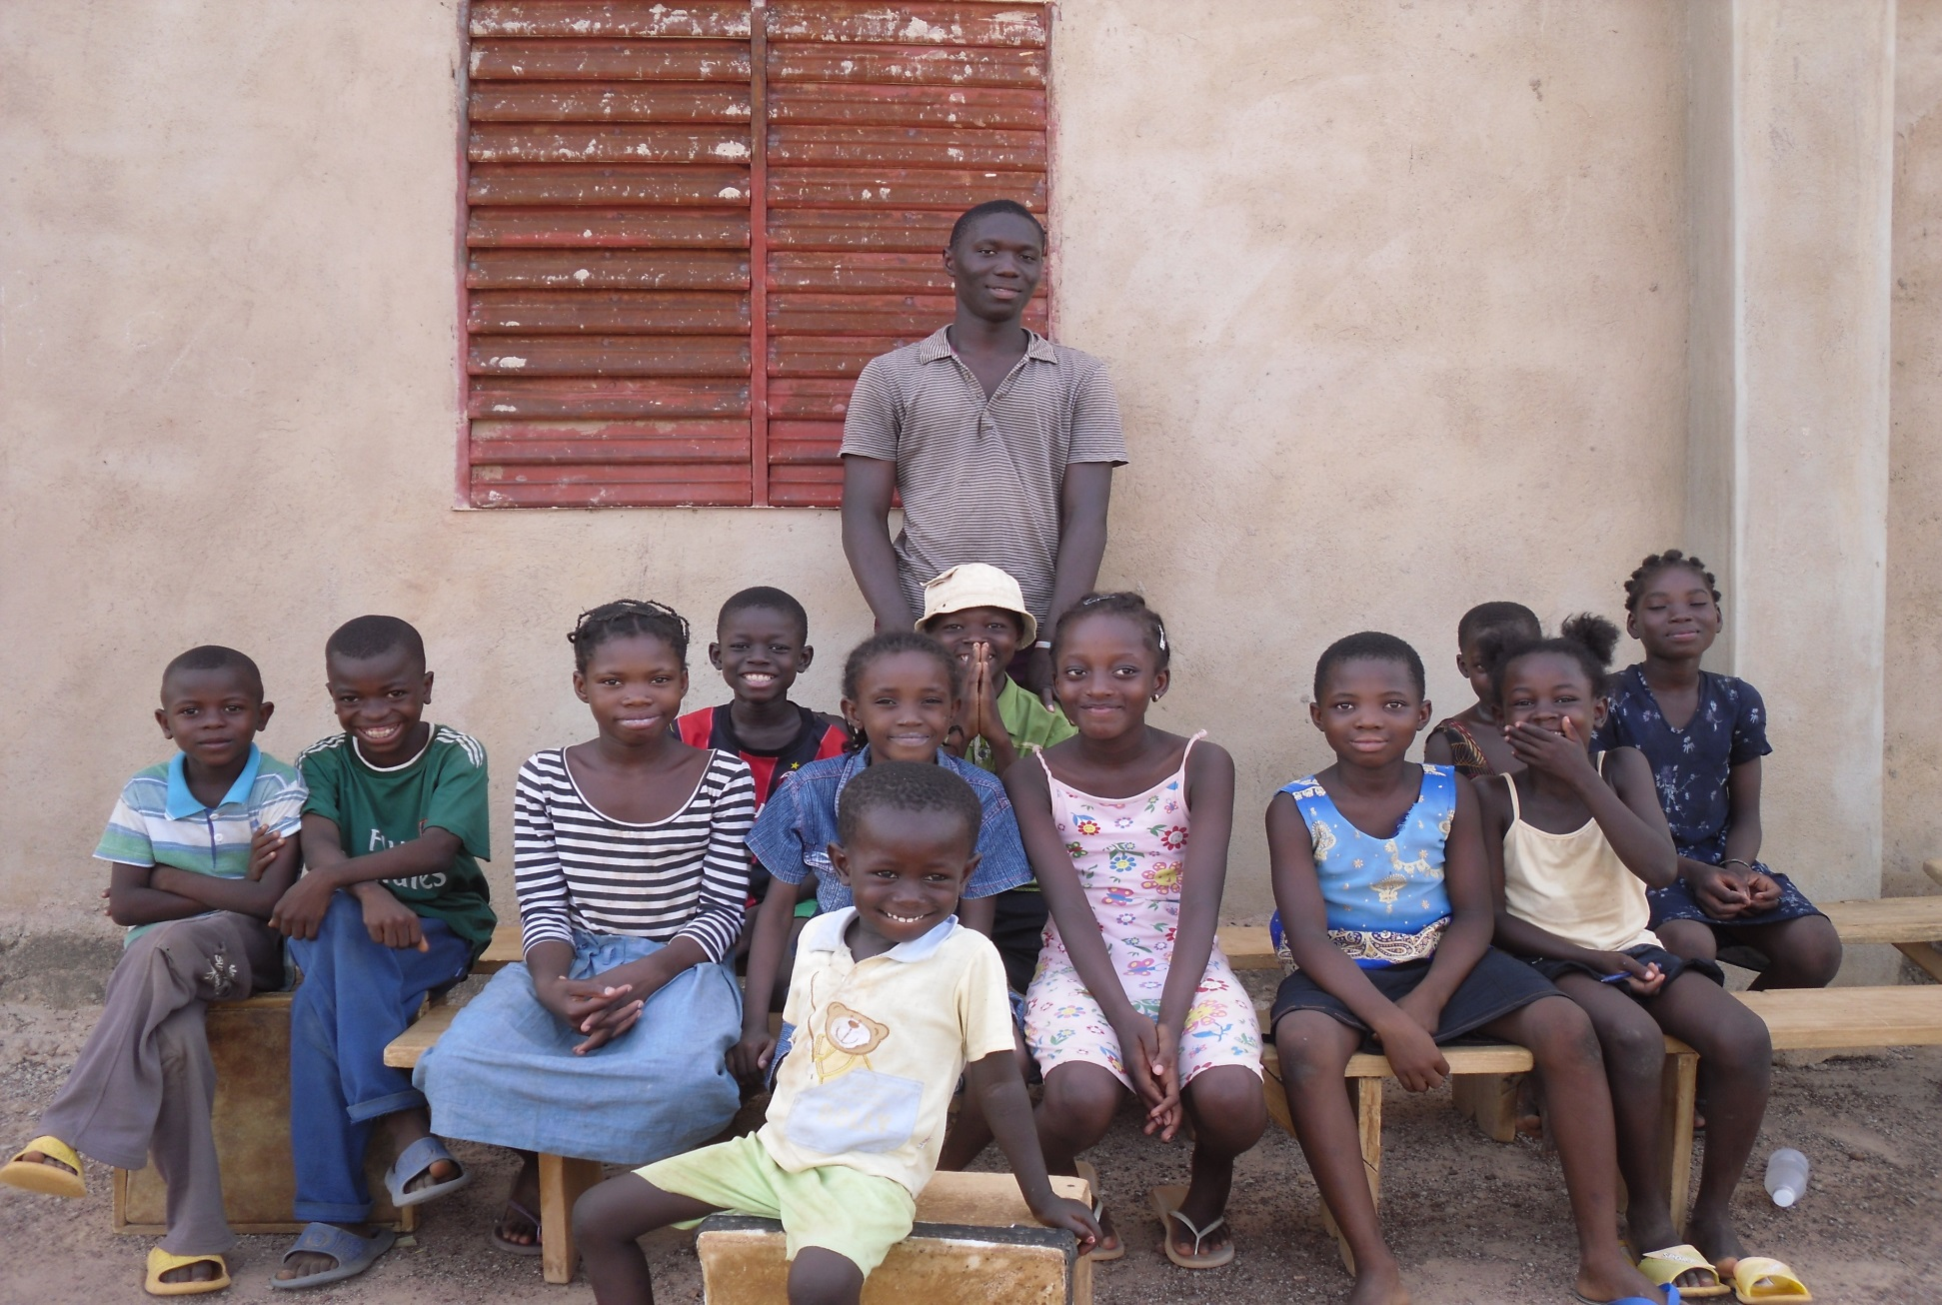
More kids

Slide 9
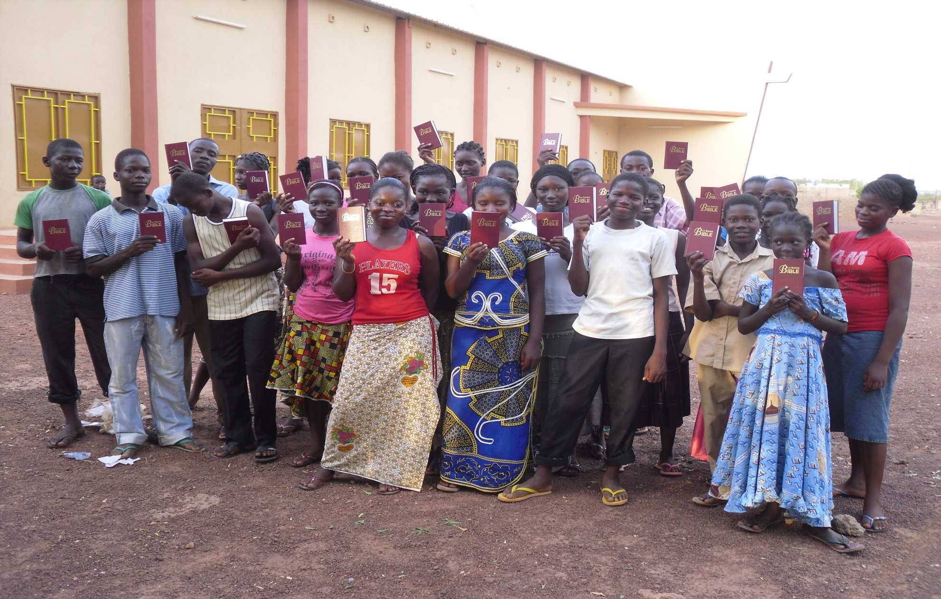
Teenagers receiving their first Bibles after an evangelistic crusade by Elisha Cho and Paw in May 2013

Slide 10
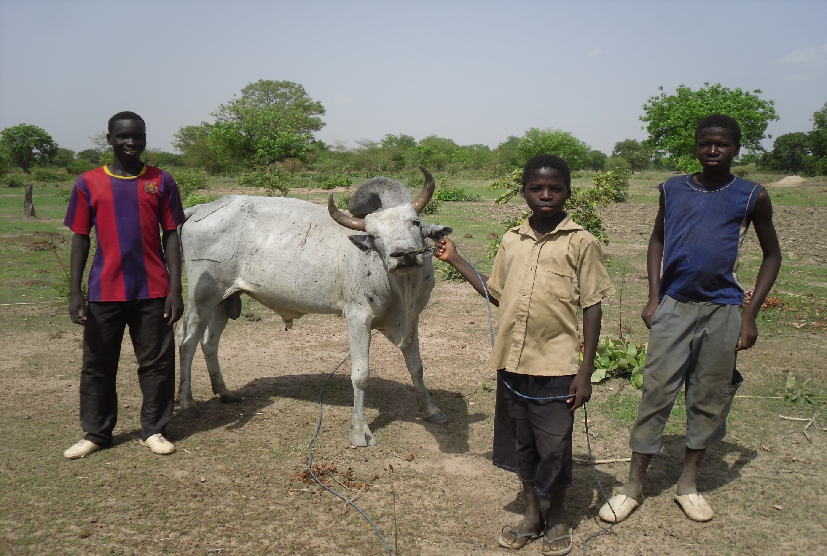
3 kids with their family ox in Tiogo

Slide 11
Ideas for Buildings
16 classrooms in long story building (8 rooms on each floor)
An apartment complex for teachers
An office building
A library and computer lab
A chapel
2 dorms for boys and girls coming from far away
A well, a pump, and a big tank for running water
And a guest house

Slide 12
Blue prints and potential cost?
Still to be confirmed
Architect and contractor will complete their work as soon as land is marked out.
Estimated date for blue prints and cost to be available: within the next few months.

Slide 13
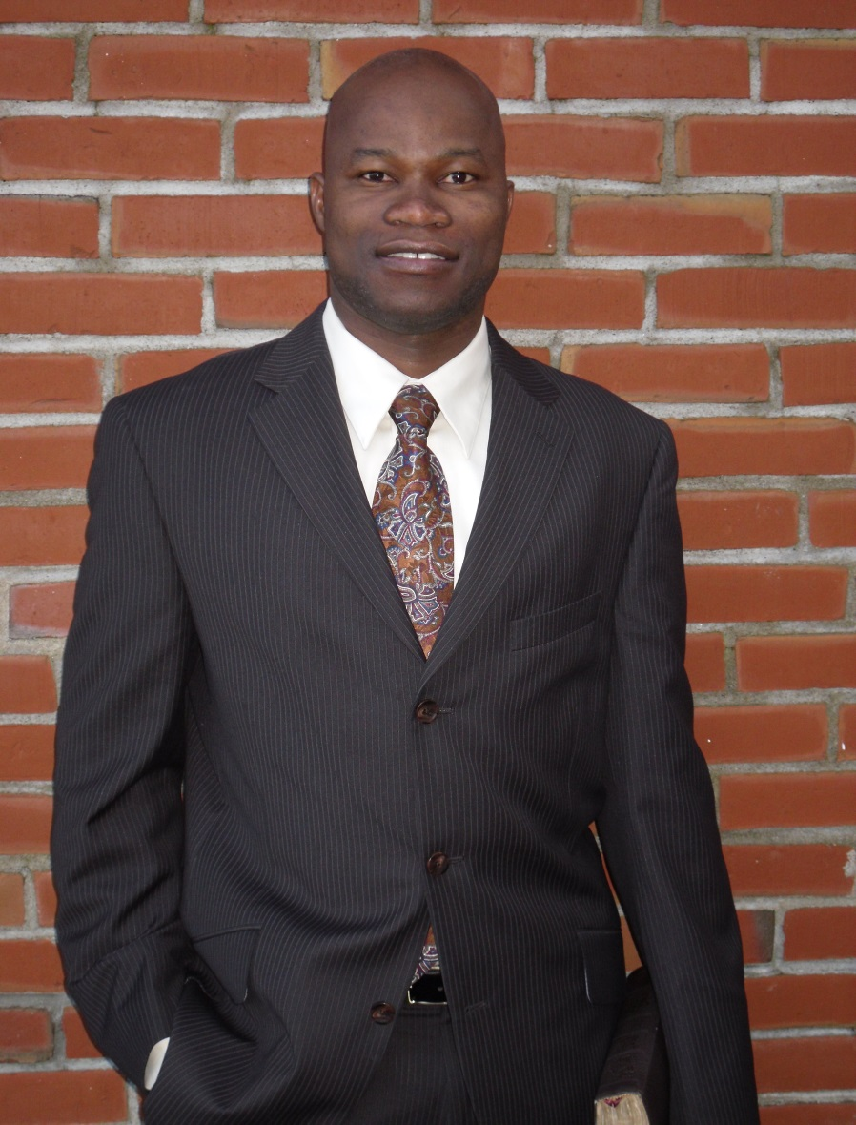
By Kombassere Pawendtare M.A.R (IP) Gordon-Conwell Theological Seminary (native of Tiogo, Burkina Faso) email: pawendtare@gmail.com

