Slide 1
Global Mission /Burkina Faso
Christmas 2016 plus Bible project

Slide 2
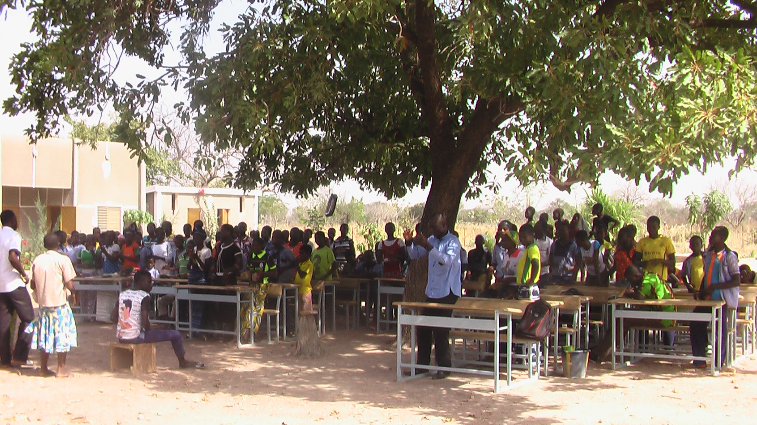
Open-air School Christmas worship

Slide 3
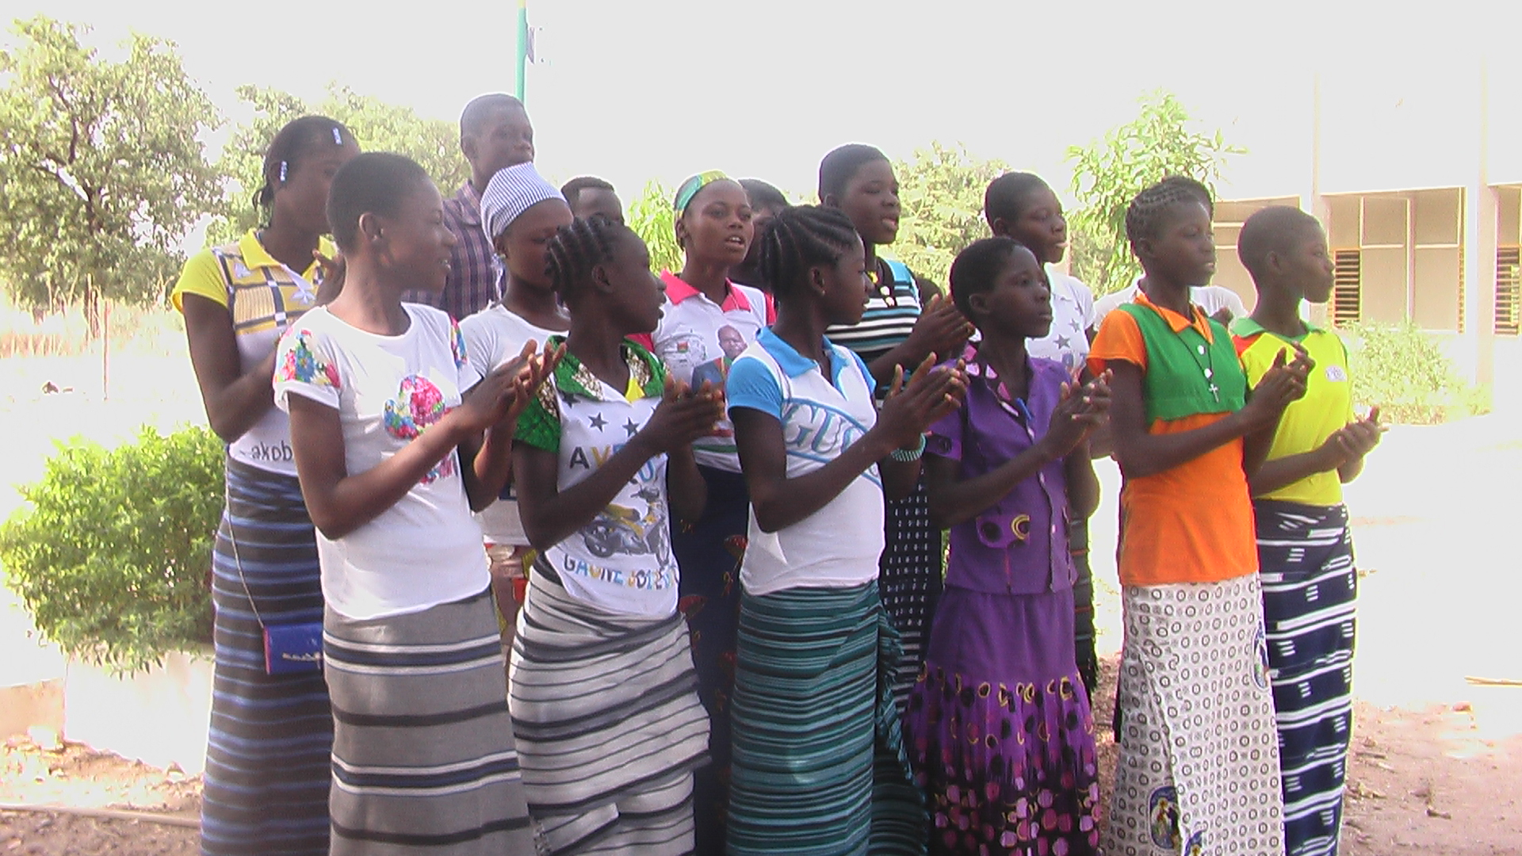
Choir of young girls singing at Christmas service (Dec. 2016)

Slide 4
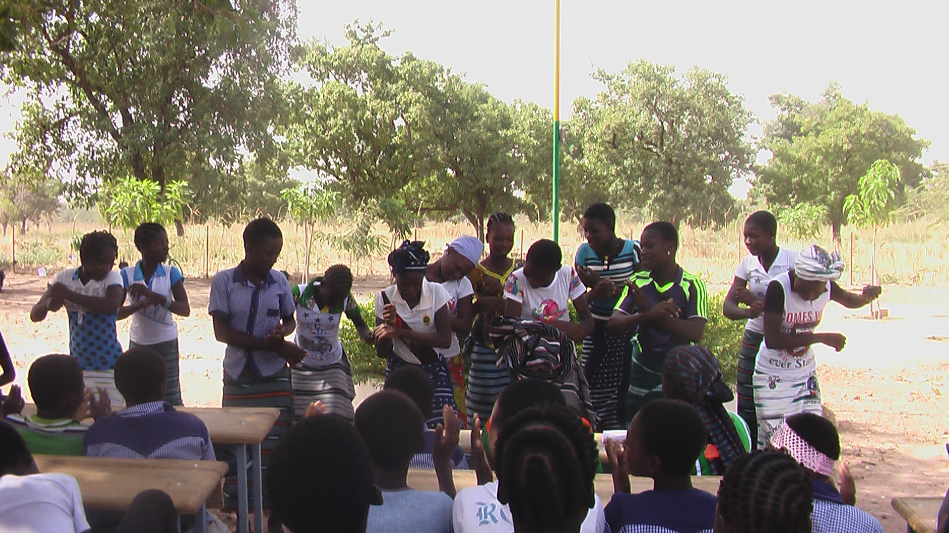
School girls singing and dancing

Slide 5
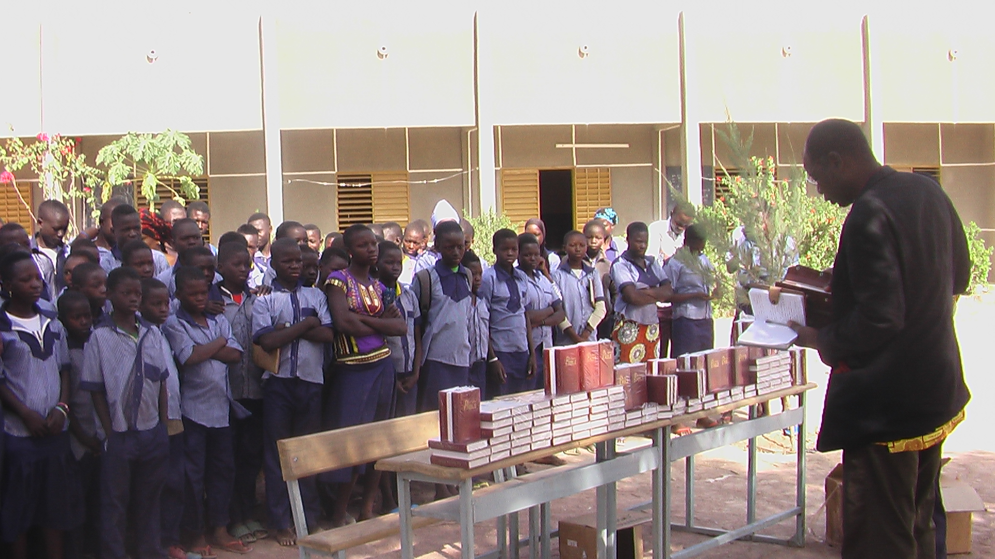
Village pastor preaching to students before Bible distribution early Jan. 2017

Slide 6
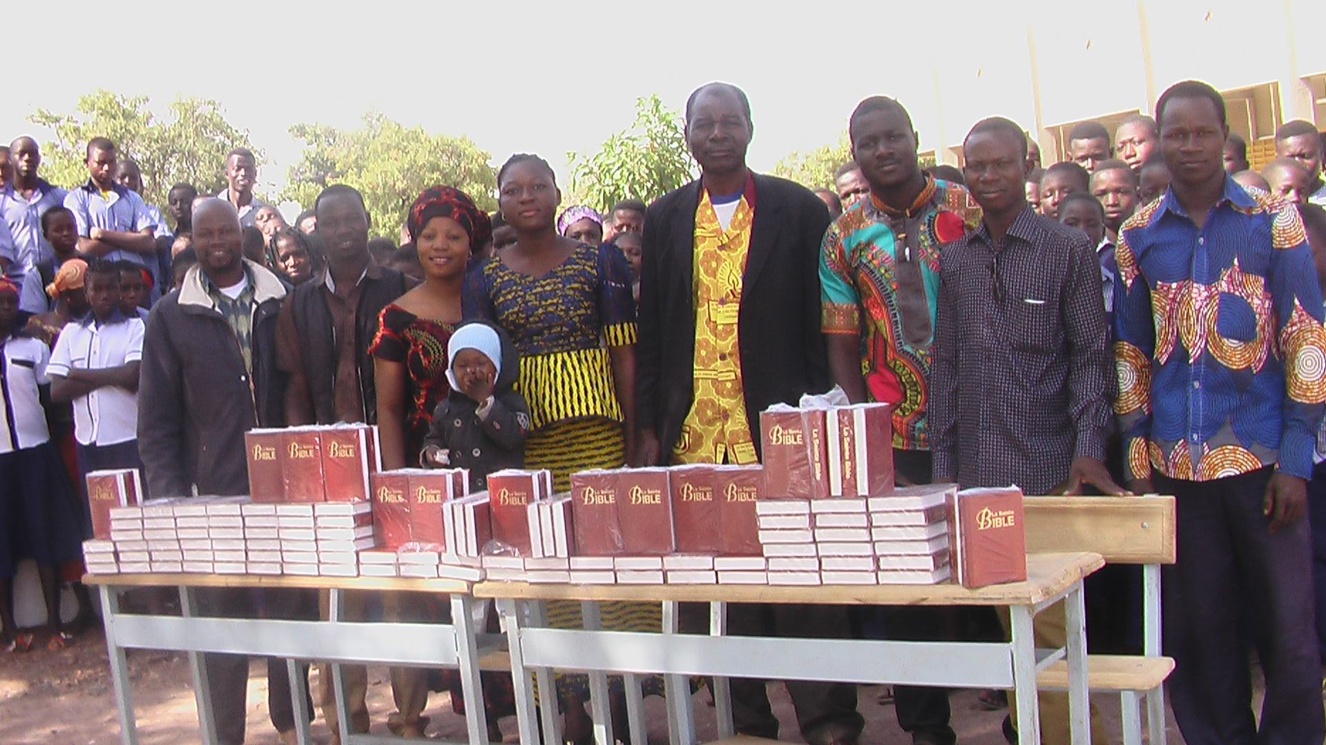
Teachers, staff and village pastor present at the Bible distribution ceremony

Slide 7
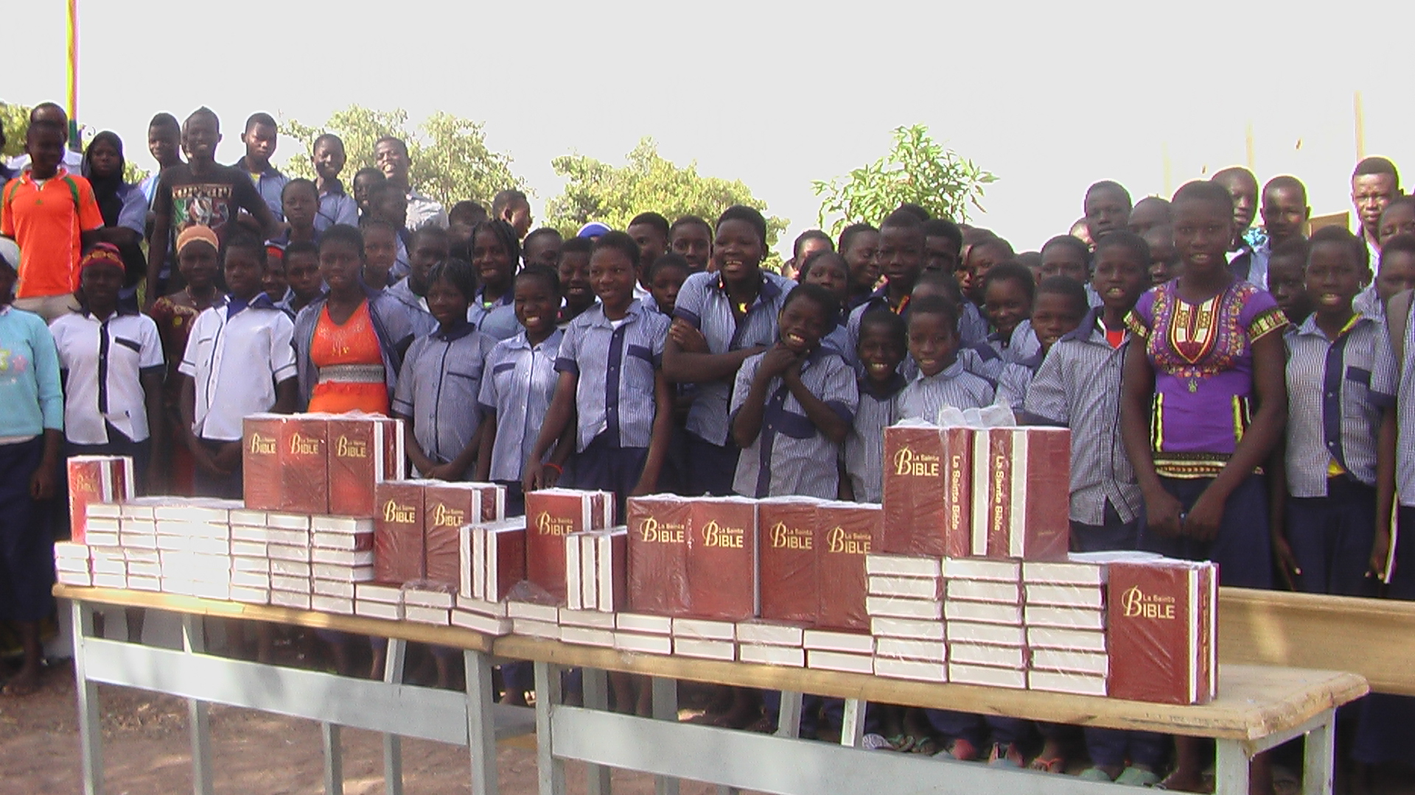
Excited students eagerly waiting to receive the word of God

Slide 8
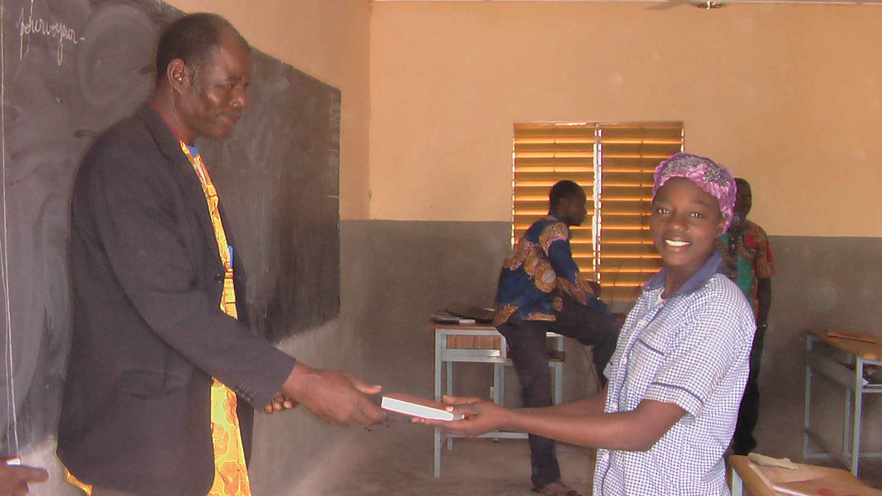
Village pastor handing out Bibles to every student

Slide 9
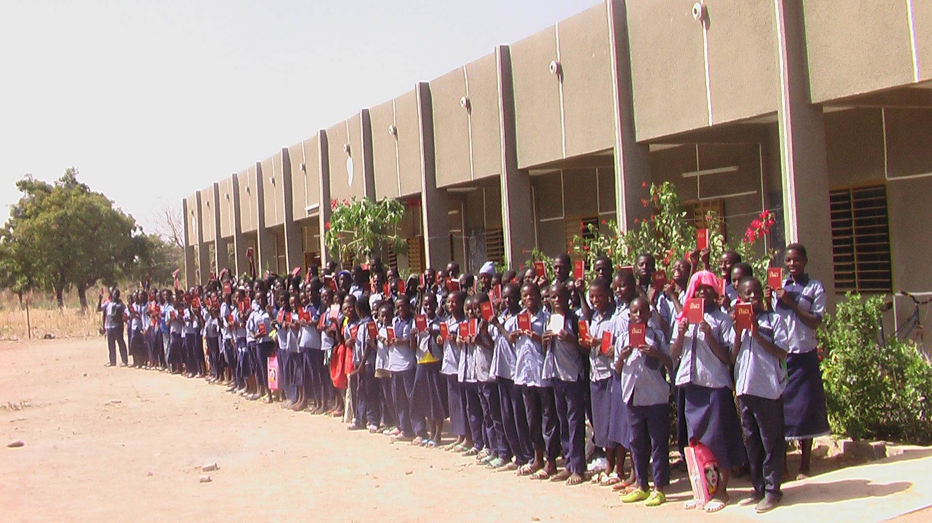
Every single one of our 136 students now has his or her own Bible

Slide 10
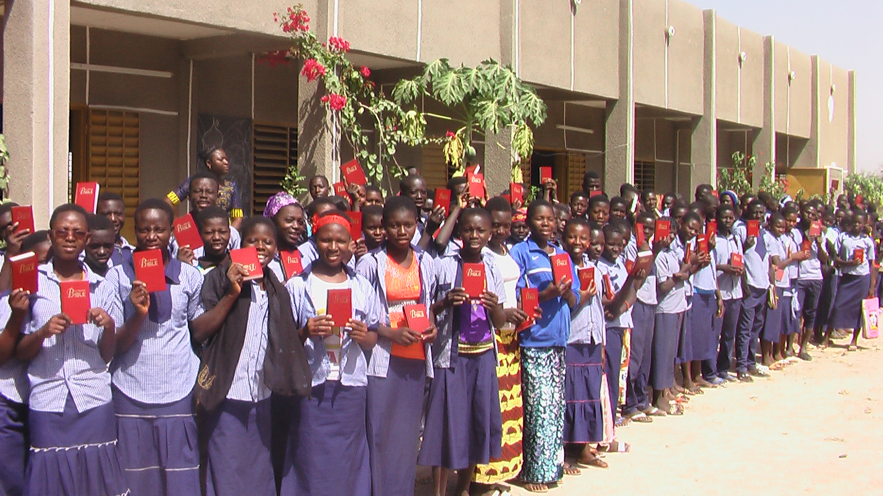

Slide 11
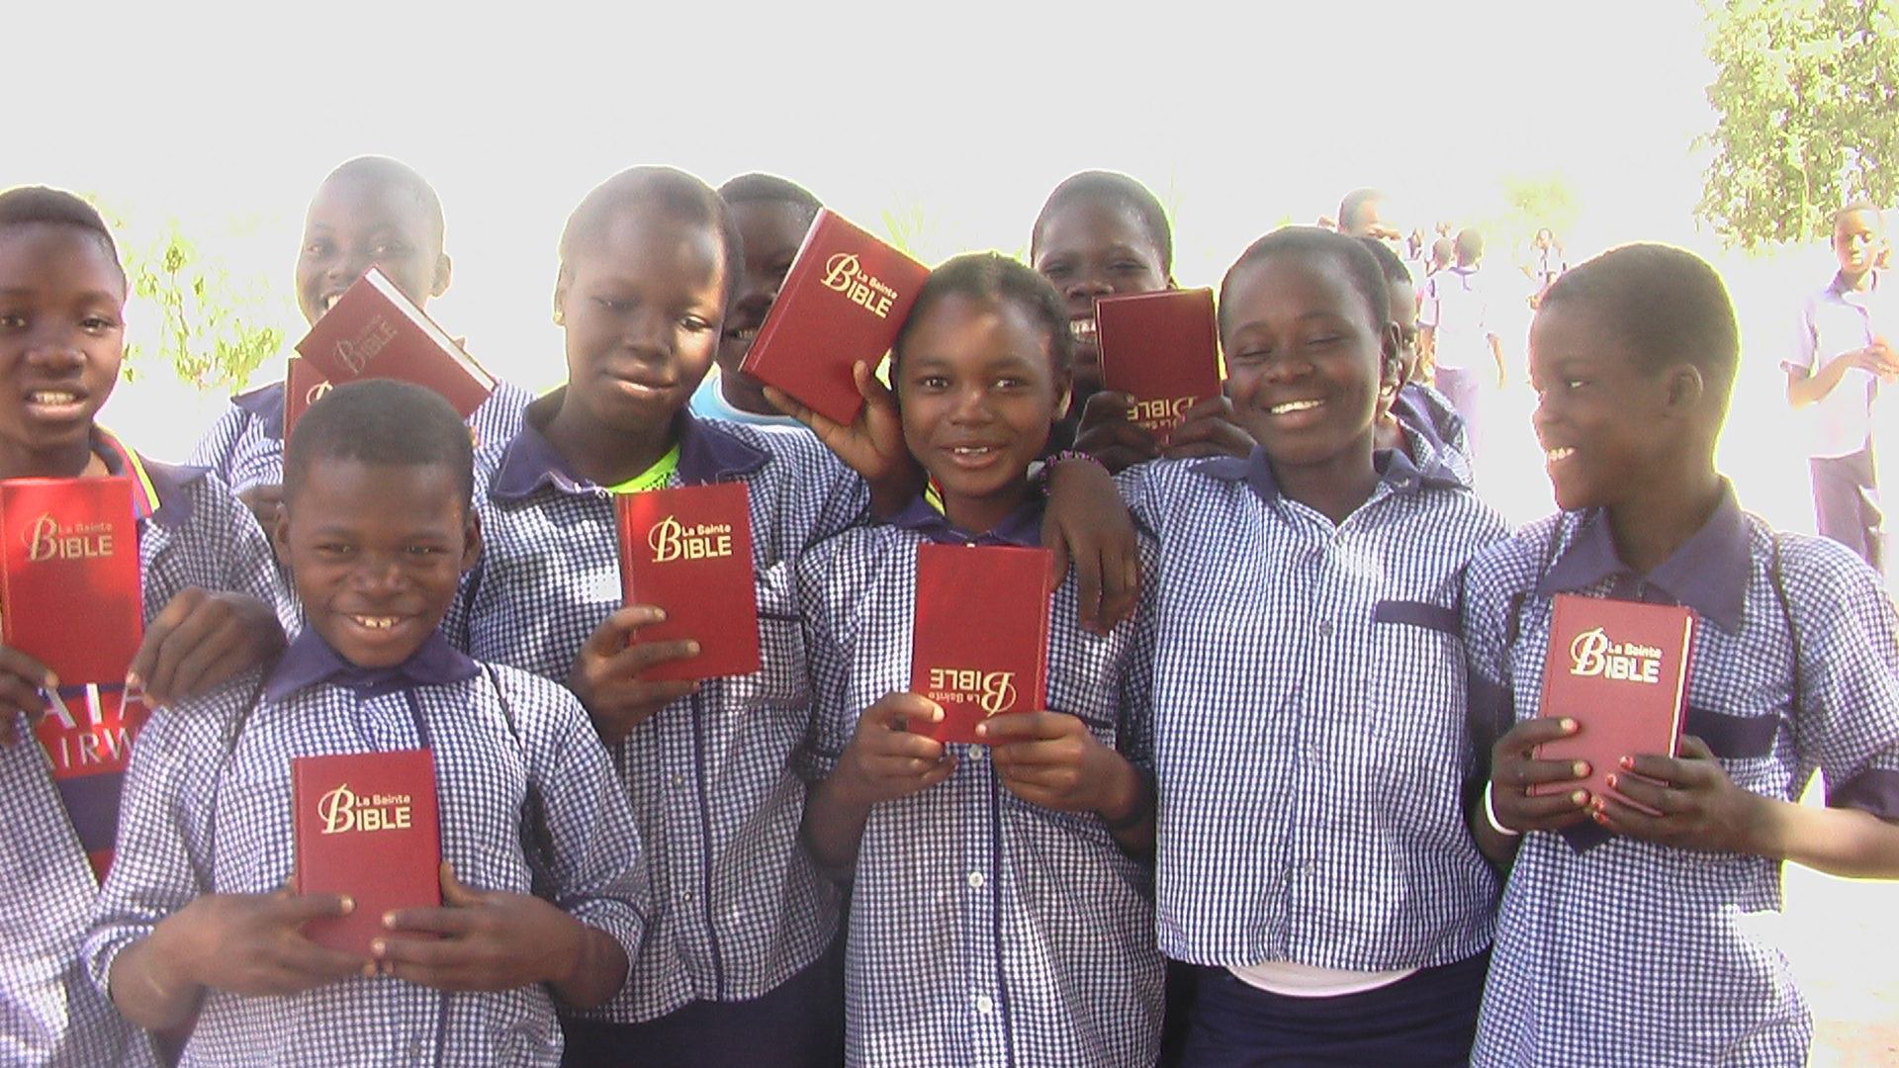
Happy students showing off their brand New Bibles

Slide 12
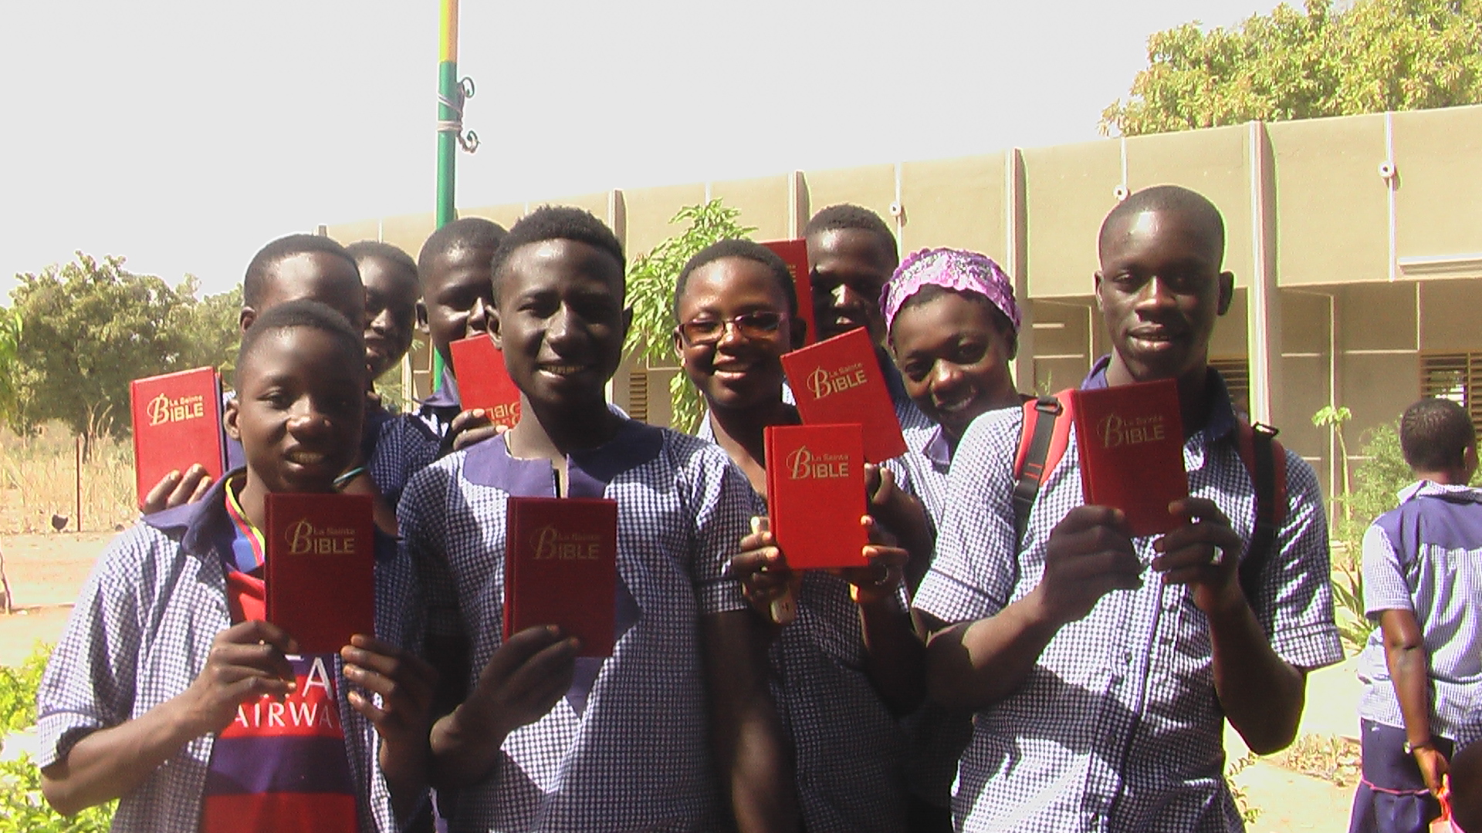

Slide 13
Thank You!
The students, staff and teachers of our school are very thankful to Dr. Park for his great leadership and his love for the people of Tiogo. We are equally grateful to all the partners of Global Mission.
With these Bibles it is now easy to lead a Bible study in class and point the life changing truths of God’s word to the students.
So far, we have had at least 40 students who openly accepted Jesus Christ as their Lord and Savior. They are being taught and discipled in the weekly school Bible studies. TO GOD BE ALL THE GLORY!!!

Slide 14
Thank You
By Pawendtare Kombassere, Local rep. Of Global Mission /Burkina Faso
Email: pawendtare@gmail.com

